Slide 1

Cron jobs in Linux

Slide 2
Cron is a Linux job scheduler that is used to setup tasks to run periodically at a fixed date or interval. Cron jobs are specific commands or shell scripts that users define in the crontab files. These files are then monitored by the Cron daemon and jobs are executed on a pre-set schedule.
To follow this guide, you should have:
A machine with Ubuntu 20.04 installed and root access privileges.
Basic Linux command-line experience.

Slide 3
Cron jobs are commands or shell scripts that are referenced in crontab files. These files are loaded into memory and monitored for pre-set actions that need to be taken. Cron wakes up every minute to examine all stored crontabs and see if any command needs to be executed in the current minute.
Additionally, Cron monitors the modification time of each crontab file on the system. If any crontab has been changed, it is automatically reloaded into memory. This way Cron doesn’t need to be restarted when a crontab modification is made.

Slide 4
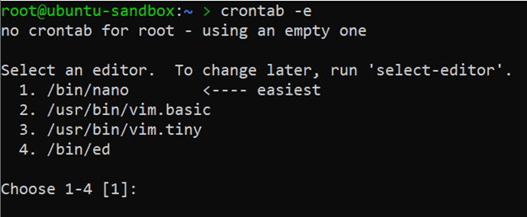

Slide 5
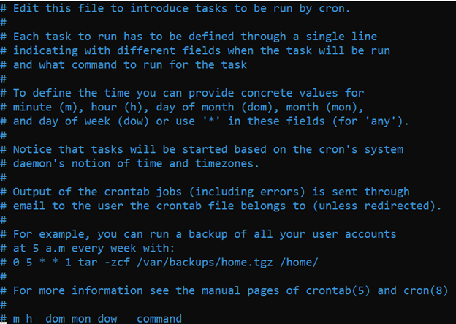
If you are creating crontab for the first time, you will be asked to select your default text editor. Select your preferred editor [1 – 4] and press ENTER to open a new crontab with your selected text editor. The newly created crontab is populated with some useful comments:

Slide 6
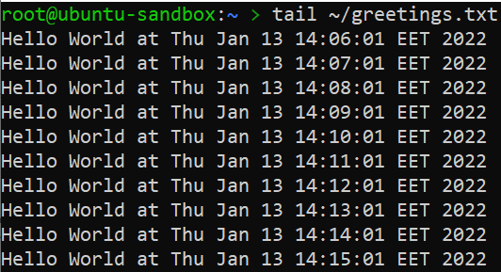
Every minute this Cron task runs the command echo “Hello World at $(date)” >> $HOME/greetings.txt. This command retrieves the current date, stuffs it into the “Hello World […]” string and appends the string to a greetings.txt file that is in your home directory. If the doesn’t exist yet, it will be created.
Save the file and exit. Wait a few minutes and check the greetings.txt file that should have been created in your home directory and populated with relevant data:

Slide 7
Every Cron task is written in a Cron expression that consists of two parts: the time schedule and the command to be executed. While the command can be virtually any command that you would normally execute in your command-line environment, writing a proper time schedule requires some practice.
The Cron task syntax consists of 6 arguments separated by spaces. First 5 arguments describe the execution time, while the last argument is a command or a full path to a shell script that is going to be executed by the default shell:
[minute] [hour] [day of month] [month] [day of week] [command]

